Slide 1
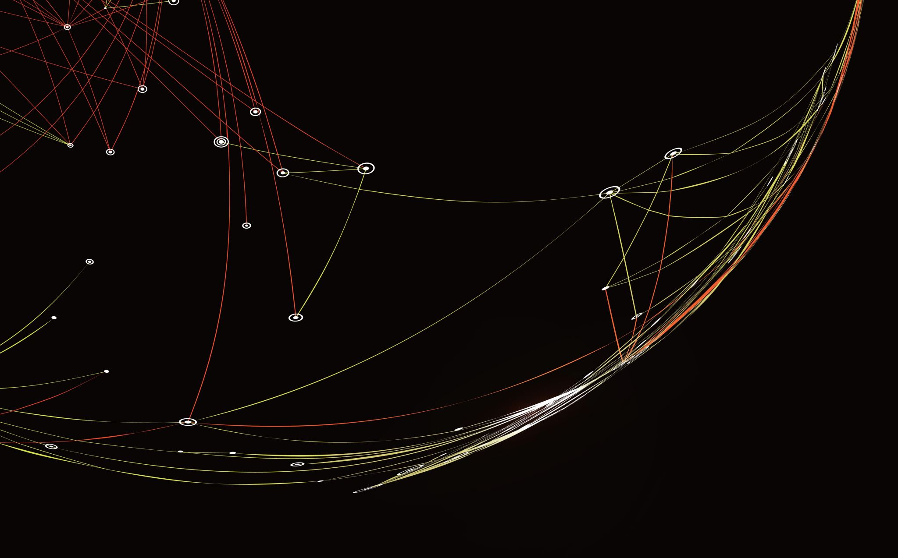
States, Economies and Societies Research Group
Jess Espey

Slide 2
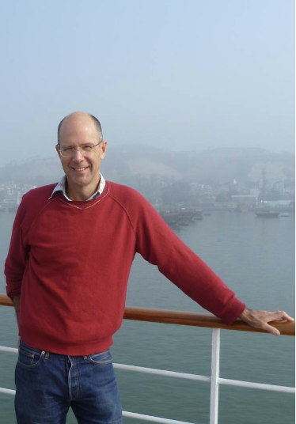
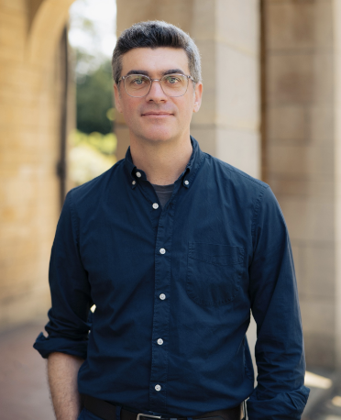
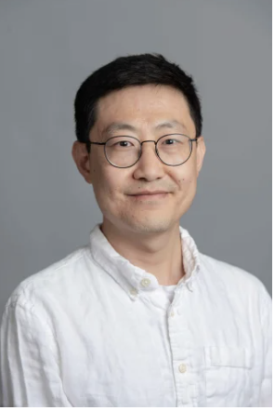
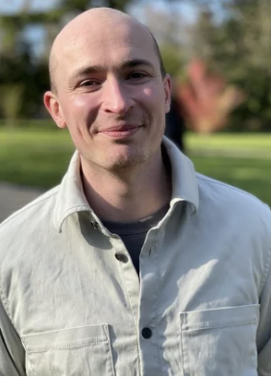
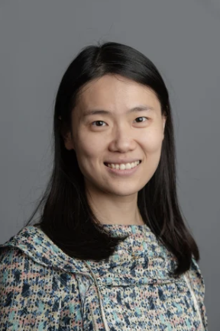
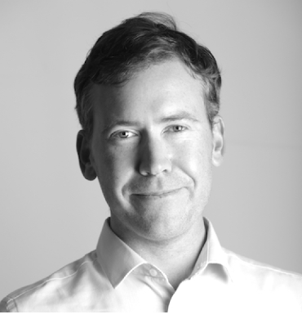
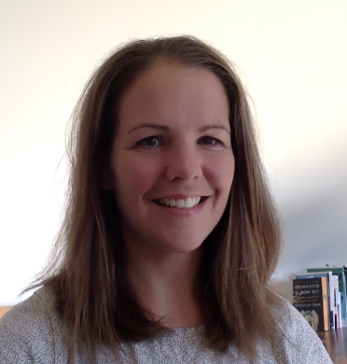
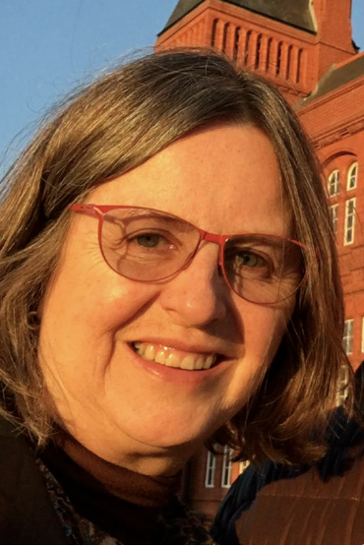
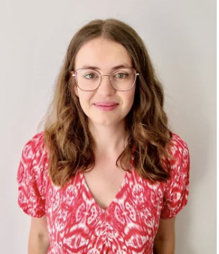
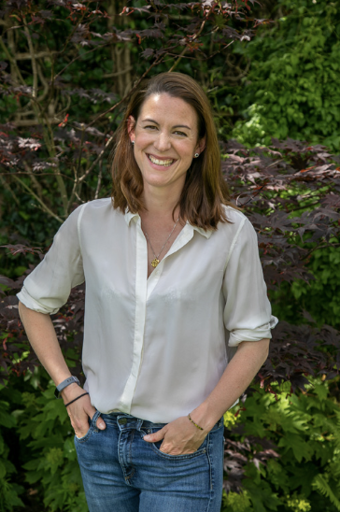
Who we are
… And lots of amazing PGRs!

Slide 3
Group description
The States, Economies & Societies research group explores a wide range of social phenomena and processes relating to governance and the economy. Key themes include inequalities across class, gender, race, ethnicity, and geography; urban and rural settlement dynamics; demographic change; political contestation and transformation; public health, medicine and biopolitics; and livelihoods under conditions of economic and environmental change.
The group interrogates questions relating to the local, national, and global-level governance of sustainable development and decarbonisation.
Our research contributes to both intellectual and policy debates across these themes with group members actively engaged with a range of non-academic stakeholders including policymakers at local, national, and international scales; NGOs; and community organisations.

Slide 4
Areas of interest
What is the state and how does it impact people’s lives?
Understanding the form, function and governance of cities.
Everyday lived experiences in different geographic contexts

Slide 5
Examples of current projects
Remote work futures (Julie)
Ambient vulnerabilities in cities (Caitlin)
AI for Urban Policy (Rui)
Rethinking State-Capital relations in urban China through the reproduction of waterscapes in Shenzhen (Quijie)
The representation of Urban Africa in multilateral processes (Sue)
Evidence use and transmission within regional governance processes (with a focus on Africa) (Jess)
Menstrual experiences of women in Western Uganda (Madison – PhD candidate)

Slide 6
Potential future areas of collaboration
Artificial intelligence and its role in urban governance
The role of science and other evidence-inputs in urban and multi-scalar policy processes
Geographies of inequality, health and wellbeing
Opportunities and inequalities in the built environment
Cities and sustainable development in the future (Sean and Jess editing a volume for Elgar and welcoming contributions)
Ideas welcome!!!!!

